Slide 1

Comparative Study of Channel Pruning Methods in Neural Network
Project Presentation On
26 May, 2021
Under Supervision of
Dr. Biju R Mohan
Mr. Pragnesh Thaker
Presented By : Group 15
Abhishek Kumar (202IT001)
Nitin Sharma (202IT017)

Slide 2

AGENDA
Motivation
Abstract
Detailed Objective
Performance Metrics
Concepts : CNN, Channel Pruning, VGG-16
Methodology
Code Snippet
Results
Visualization
Observation
Problems Faced
Conclusion and Future Work

Slide 3
MOTIVATION
Machine Learning software can often be so computationally intensive that it is unsuited for lightweight mobile/IoT devices. Here, we explore the idea of how they may not need to be as massive as they are.
Our focal point here will be deep CNN models and accelerating it.
Structured simplification is a CNN based acceleration technique which mainly involves Tensor Factorization, Sparse connection and Channel pruning.
Channel pruning is used to reduce feature map depth, and it shrinks a network into a thinner one by reducing the number of channels in each layer.
Pruning channel theoretically is a simple task, but it is very challenging as removing channels in one layer might drastically change the input of following layers.
To perform this we will focus on a two-step process. In first step we are going to focus on figuring out the most redundant channel and in second step we reconstruct the output with remaining channels.

Slide 4
ABSTRACT
Here, we work on a channel pruning technique to accelerate the very deep neural network which is a two-step algorithm.
Firstly, this pruning technique will be applied on single layer models and later it will be extended to multilayer and on whole networks as well.
In step one, the most redundant channel will be selected by using the LASSO regression/Ridge regression. No. of channels to prune will be decided by rate of pruning ‘r’.
In step two, reconstruction will be done because we have to generate the same output.
We do these two steps iteratively until certain acceleration will be gained which is basically decided by how much decrease in accuracy we can afford.
Objective : Perform channel pruning on VGG-16 model and compare the performance metrics of the model before and after pruning using Imagenet dataset.

Slide 5

DETAILED OBJECTIVES
To understand VGG-16 model.
To understand channel selection criteria using L1-Norm.
To perform single layer pruning on VGG-16 model.
To perform multi layer pruning on VGG-16 model .
To perform whole model(Global Pruning) pruning on VGG-16 model.
To understand channel selection criteria using L2-Norm (Our Contribution)
and perform single layer pruning, multi layer pruning, while model(Global Pruning) pruning on VGG-16 model.

Slide 6

PERFORMANCE METRICS
Test Accuracy : Total correct predictions out of total test cases.
Speed-up ratio : Improvement in time for prediction
FLOP : Reduction in floating point operations in keras model
% Param Reduction : Will represent amount of total parameters that are going to get reduced after pruning compared to the no of parameter that were there in original model. (model.trainable_weights, model.non_trainable_weights, model.summary)
Model Space Consumption : How much space has been consumed by the model? (using Os.stat(pass_model).st_size)

Slide 7
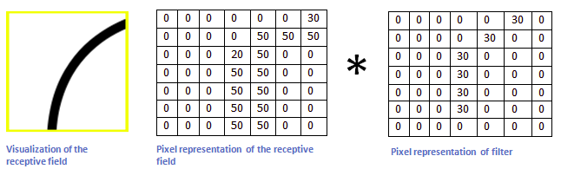
UNDERSTANDING CNN
A detailed overview of what CNNs would be that it takes the image, pass it through a series of convolutional, nonlinear, pooling (downsampling), and fully connected layers, and get an output.
The output can be a single class or a probability of classes that best describes the image.
We here are interested in convolution layer of CNN models and this layer performs an operation called convolution.

Slide 8
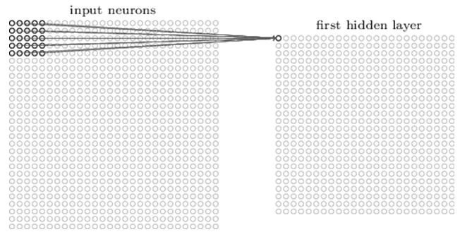
UNDERSTANDING CNN
Given example was a small part of actual processing happening in a convolution layer.
Each of the multiple filters traverse over the input image and give rise multiple feature maps.
Channels
A colored image would have 3 channels - RGB.
For each filter in the first layer, we apply it to each input channel separately, and add the results together to get the corresponding output channel.

Slide 9
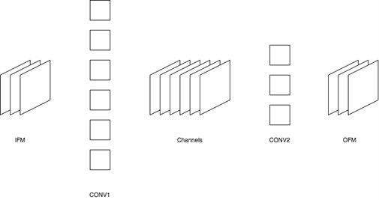
CHANNEL PRUNING
Number of computations in convolution layer is far greater than in any other layer.
This is because as no of filters increases in convolution layer, there are loads of increase in calculations required to generate feature maps.
This gives us insight on why pruning of convolution layer is far more important than at any other layer.

Slide 10

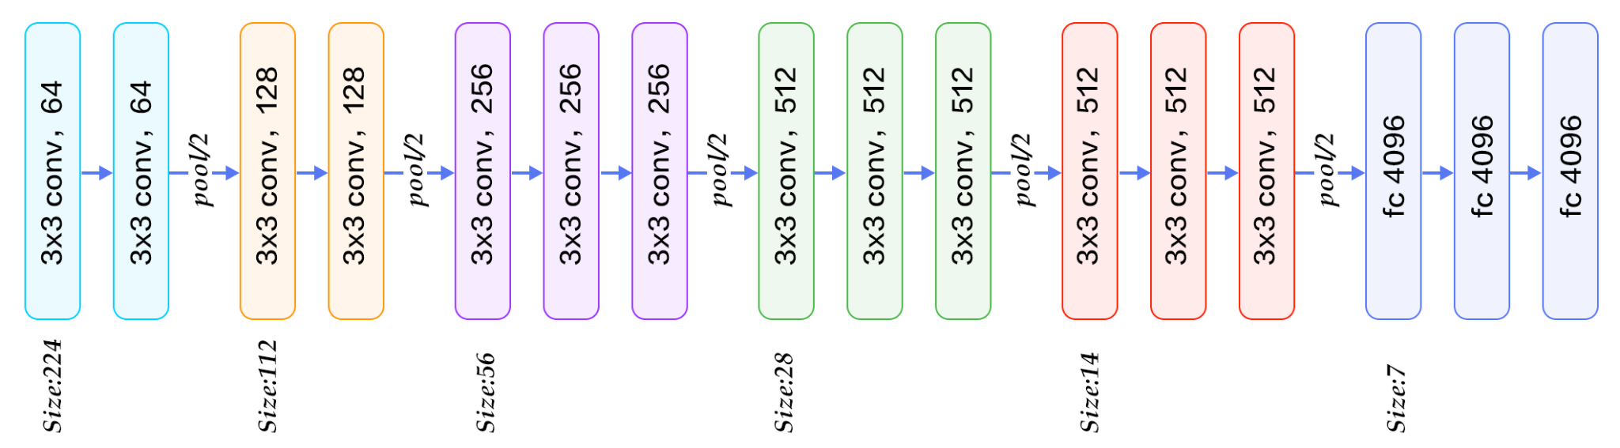
MODEL : VGG16 ARCHITECTURE
VGG16 is a CNN architecture which was winner Imagenet competition in 2014.
The 16 in VGG16 refers to it has 16 layers that have weights. This network is a pretty large network and it has about 138 million (approx) parameters.

Slide 11
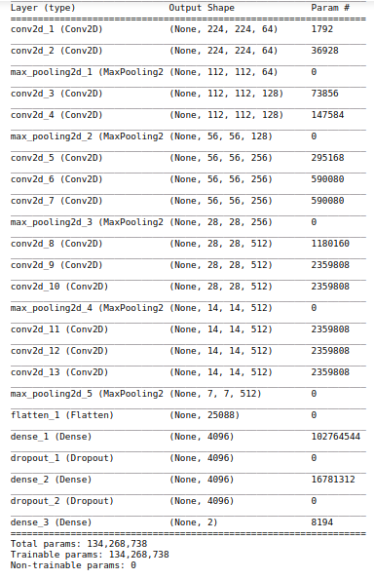
MODEL : VGG16 ARCHITECTURE
Unique thing about VGG16 is that they focused on having convolution layers of 3x3 filter with a stride 1 and always used same padding and max-pool layer of 2x2 filter of stride 2.
It follows this arrangement of convolution and max pool layers consistently throughout the whole architecture.
In the end it has 3 FC(fully connected layers) with 4096 neurons each followed by a softmax for output.

Slide 12
METHODOLOGY
Load pretrained VGG-16 model and evaluate performance metrics for them.
Perform channel pruning of the models.
Main pruning steps
Select the least representative /most redundant channel using Lasso regression/Ridge regression and prune that (using Keras-Surgeon).
Then do the reconstruction of outputs of remaining channels.
Now after doing above two steps, we have to find accuracy, number of parameters,model size and floating point operations.
Compare these metrics before and after pruning.

Slide 13
DETAILED METHODOLOGY
Multi Layer Pruning
First select the convolution layers and get the weight tensors(or stack of channels) at each convolution layers.
Find the respective Norm(depending upon channel selection criteria) and sort them layer wise according to most redundant channel.
Define rate of pruning and multiply it with number of channels at each conv layer and get the details of channels to delete.
Then delete those selected channels from their respective conv layer and do fine tuning.
And finally note down all performance metrics.
Whole Model Pruning
First select the convolution layers and get the weight tensors(or stack of channels) at each convolution layers.
Go through all convolution layers and find the respective norm(based upon channel selection criteria) and save it in a dictionary in like key=(layer_index,channel_index) and values as norm.
Sort the dictionary based on value of dictionary(i.e. norm) so that we can get most redundant channels.
Define the rate and multiply it with length of dictionary to get total number of channels to delete.
Now do the deletion of channels and do the fine tuning note down the performance matrices.

Slide 14
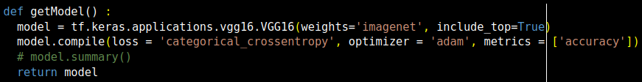
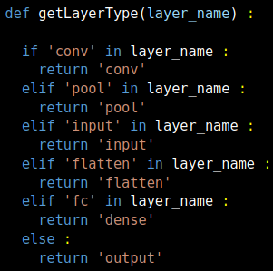
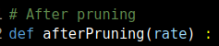
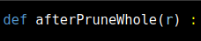
CODE SNIPPET : Helper Code
Generating Model
Get Layer Type
Methods for Pruning

Slide 15
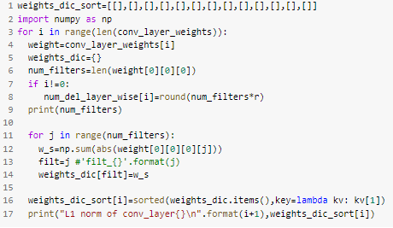
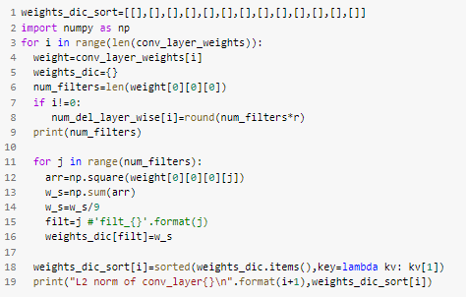
CODE SNIPPET : Multi Layer Pruning
Channel selection with L1-Norm
Channel selection with L2-Norm

Slide 16
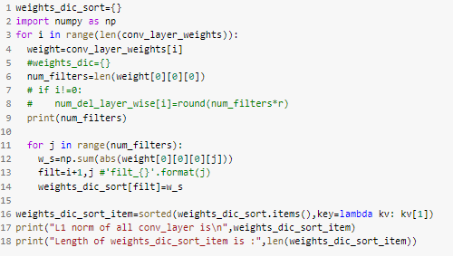
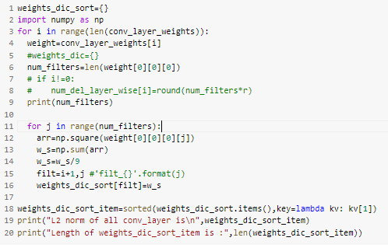
CODE SNIPPET : Whole model Pruning
Channel selection with L1-Norm
Channel selection with L2-Norm

Slide 17
RESULTS : MultiLayer - L1
(Before Pruning)
Accuracy - 98.8%
Total parameters - 138,357,544
Space - 528 MB
FLOP (Total) - 30,390,582,674
L! Regression - Multi Layer Pruning
Rate | Accuracy (%) | Parameter after pruning | Space (MB) | FLOP (/10^10)
0.01 | 97.67 | 137,082,213 | 523 | 3.039
0.02 | 95.34 | 135,824,111 | 518.2 | 2.997
0.03 | 96.51 | 134,553,649 | 513.36 | 2.994
0.04 | 97.67 | 133,303,521 | 508.59 | 2.897
0.13 | 94.18 | 121,588,415 | 463.90 | 2.486
0.14 | 97.64 | 120,345,493 | 459.16 | 2.437
0.15 | 89.53 | 119,121,258 | 454.49 | 2.394
0.16 | 84.88 | 117,886,267 | 449.78 | 2.358
Table - Results for different values of rate in multilayer after pruning

Slide 18
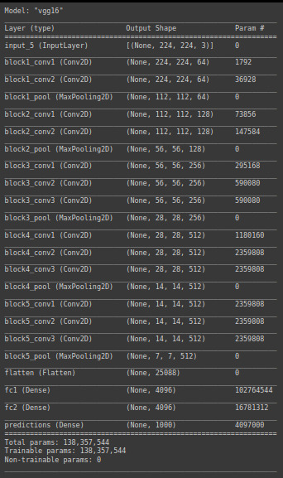
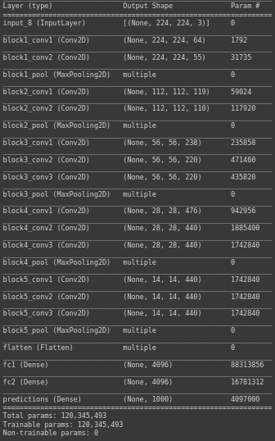
MODEL SUMMARY : Multilayer - L1
Fig. model summary before pruning
Fig. model summary after pruning

Slide 19
RESULTS : Whole - L1
(Before Pruning)
Accuracy - 98.8%
Total parameters - 138,357,544
Space - 528 MB
FLOP (Total) - 30,390,582,674
L1 Regression - Whole Model Pruning
Rate | Accuracy (%) | Parameter after pruning | Space (MB) | FLOP (/10^10)
0.01 | 96.51 | 138254142 | 527.47 | 2.976
0.02 | 94.18 | 138120680 | 526.9 | 2.868
0.03 | 84.88 | 137926864 | 526.2 | 2.785
0.04 | 67.44 | 137727836 | 525.4 | 2.702
0.05 | 62.79 | 137514805 | 524.6 | 2.628
Table - Results for different values of rate for whole model pruning

Slide 20
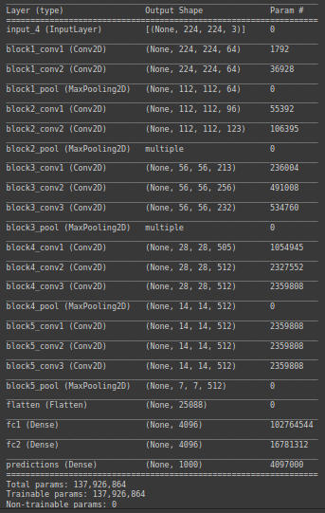
MODEL SUMMARY : Whole - L1
Fig. model summary before pruning
Fig. model summary after pruning

Slide 21
RESULTS : Multilayer - L2
(Before Pruning)
Accuracy - 98.8%
Total parameters - 138,357,544
Space - 528 MB
FLOP (Total) - 30,390,582,674
L2 Regression - Multi Layer Pruning
Rate | Accuracy (%) | Parameter after pruning | Space (MB) | FLOP (/10^10)
0.01 | 95.23 | 137082213 | 523 | 3.039
0.02 | 96.42 | 135824111 | 518.2 | 2.997
0.03 | 95.23 | 134553649 | 513.36 | 2.944
0.04 | 95.23 | 133303521 | 508.59 | 2.897
0.12 | 94.04 | 123057783 | 469.50 | 2.527
0.13 | 89.28 | 121588415 | 463.90 | 2.486
0.14 | 76.18 | 120345493 | 459.16 | 2.437
Table - Results for different values of rate in multilayer after pruning

Slide 22
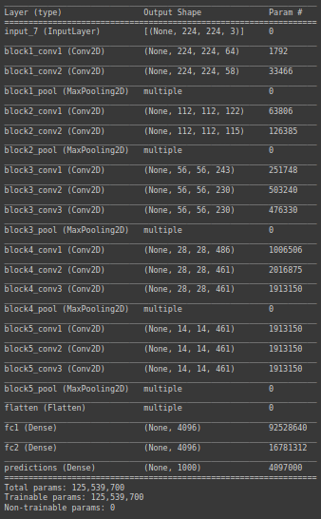
MODEL SUMMARY : Multilayer - L2
Fig. model summary before pruning
Fig. model summary after pruning

Slide 23
RESULTS : Whole - L2
(Before Pruning)
Accuracy - 98.8%
Total parameters - 138,357,544
Space - 528 MB
FLOP (Total) - 30,390,582,674
L2 Regression - Whole Model pruning
Rate | Accuracy (%) | Parameter after pruning | Space (MB) | FLOP (/10^10)
0.01 | 97.62 | 138165060 | 527.14 | 2.982
0.02 | 96.43 | 137897678 | 526.12 | 2.905
0.04 | 97.62 | 137326301 | 523.94 | 2.766
0.05 | 97.62 | 136833744 | 522.06 | 2.710
0.06 | 94.05 | 136547489 | 520.97 | 2.655
0.07 | 88.1 | 136271593 | 519.92 | 2.595
Table - Results for different values of rate for whole model pruning

Slide 24
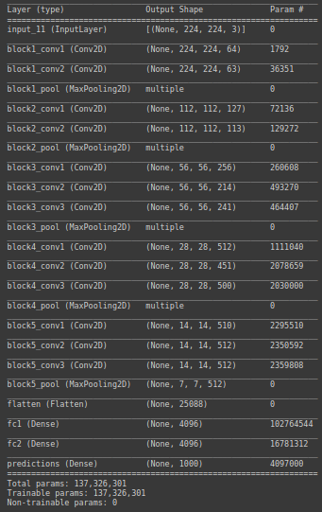
MODEL SUMMARY : Whole - L2
Fig. model summary before pruning
Fig. model summary after pruning

Slide 25
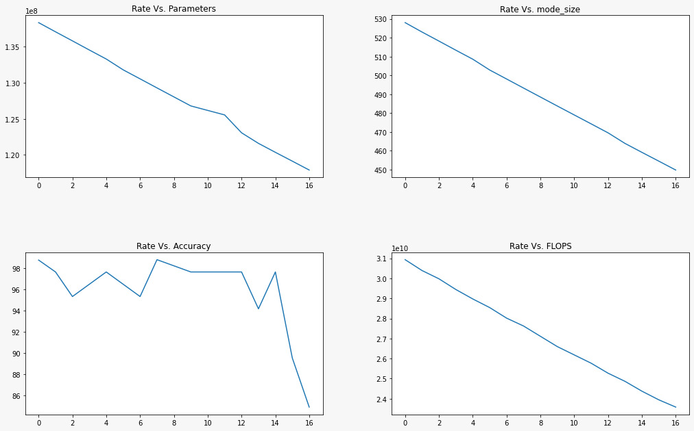
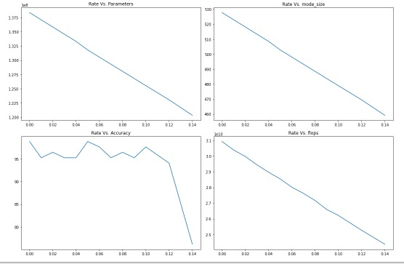
VISUALIZATION : Multilayer - L1 vs L2

Slide 26
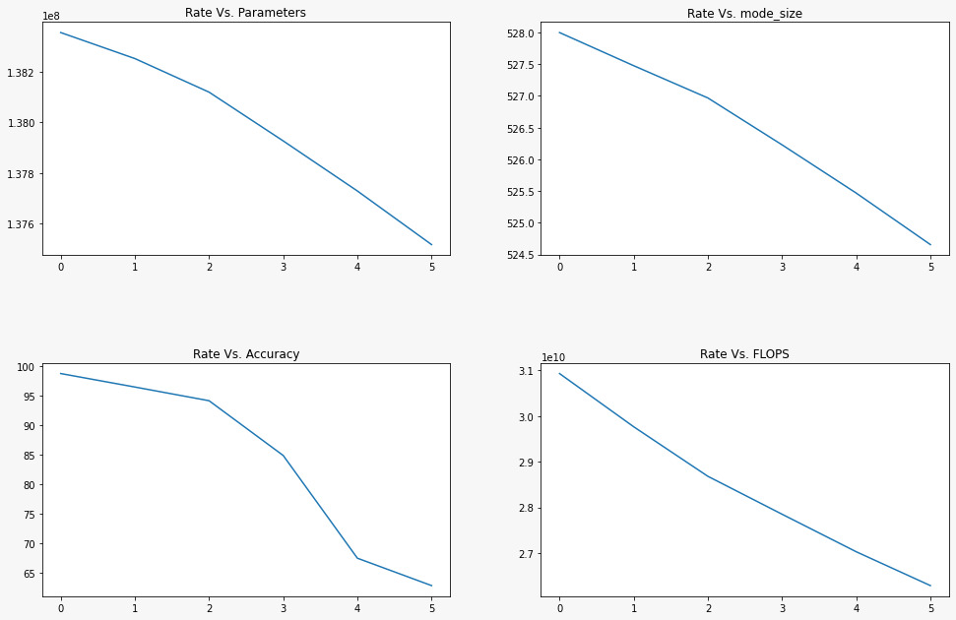
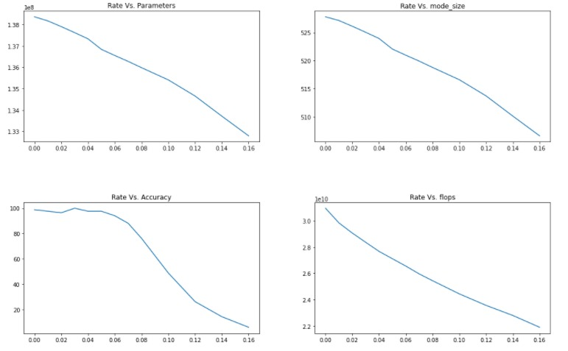
VISUALIZATION : Whole Model-L1 vs L2

Slide 27
OBSERVATION
Multi-Layer Pruning
In case of pruning of channels selected by L1 regression, we were able to prune up to 14% pruning rate per layer without losing more than 5% in accuracy. At this point, memory required to save the model reduced from 528 MB to 459 MB, floating point operation reduced by 22% and total parameters reduced by 14%.
In case of L2 regression, we were able to prune up to 12% pruning rate per layer without losing more than 5% in accuracy. At this point, memory to save model reduced to 469.5 MB, FLOP reduced by 19% and total parameters reduce by 12%.
So it can be seen that L1 method out-performed L2 one.
Whole Model Pruning
In case of L1 regression, we achieved the best performance in case of pruning rate of 2% with 8% reduction in floating point operations.
In case of L2 regression we could achieve 15% reduction in FLOP with pruning rate of 6%.
In case of whole model pruning L2 method outperformed L1.
It can be clearly observed that multilayer pruning is better than the whole model pruning.

Slide 28
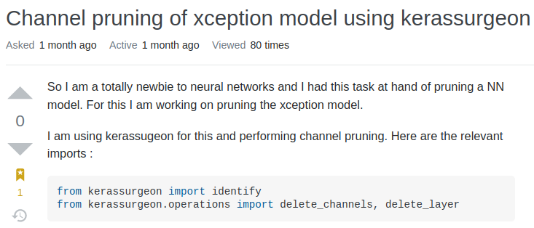
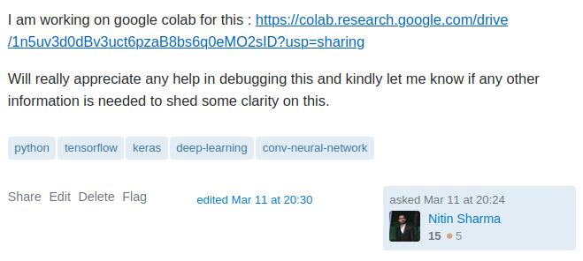
MAJOR PROBLEM FACED
Tensor Flow Version Conflicts

Slide 29
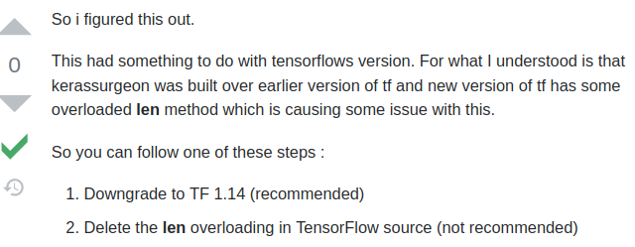
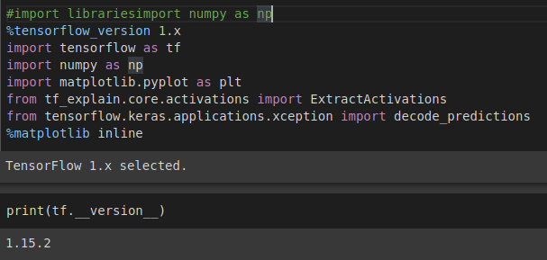
MAJOR PROBLEM FACED
Solution : Tensor Flow Version Conflicts

Slide 30
CONCLUSION
We have performed comparative analysis to find the best method for channel pruning. Here, we considered L1 and L2 regularization method for channel selection for multi layer and whole model pruning.
We observed that multi layer pruning performed better than whole model pruning. In multi-layer pruning, L1 method of channel selection outperformed L2 one. While in whole model pruning, L2 method outperformed L1 one method of channel selection.
Best result that we could find was in case of multi layer pruning with L1 regression for channel selection and 22% reduction in floating point operation and 14% reduction in parameters.
Future Work : Extend this work for more complex network like Res-net and Dense-net and explore other channel selection techniques

Slide 31
REFERENCES
Channel pruning for accelerating very deep neural networks: https://ieeexplore.ieee.org/document/8237417
Towards Datascience blog on parameter evaluation https://towardsdatascience.com/understanding-and-calculating-the-number-of-parameters-in-convolution-neural-networks-cnns-fc88790d530d
Towards Datascience blog on pruning CNN https://towardsdatascience.com/pruning-convolutional-neural-networks-cae7986cbba8
Kerop Library : https://pypi.org/project/kerop/
Keras-Surgeon Documentation : https://github.com/BenWhetton/keras-surgeon

Slide 32
THANK YOU!!!

